Slide 1
Idea & Basis of the application
Sharing your most important memories with your most important people, and packaging them in a compelling and artistic manner.

Slide 2

Why is it useful
Privacy
Redundancy
Collaborative work
Artist Market Place

Slide 3
Requirements
(Collaboratively) create memories in the form of a collection of photos
Share memories with other a limited number of friends
Provide an overview of already published memories by year
Choose cover photo from a collection based on current location. Some of which may be premium content offered by local artists.
Personalise each photo by adding notes on the back
Be able to save a work in progress version of each memory before you share it (save for later before you share).
Share your memory with people who haven’t yet registered with the application via email

Slide 4
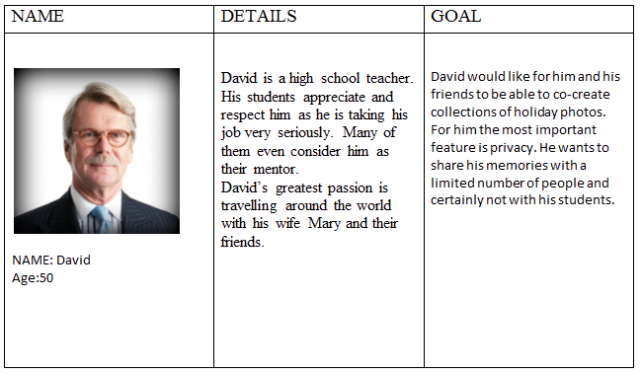
Personas

Slide 5
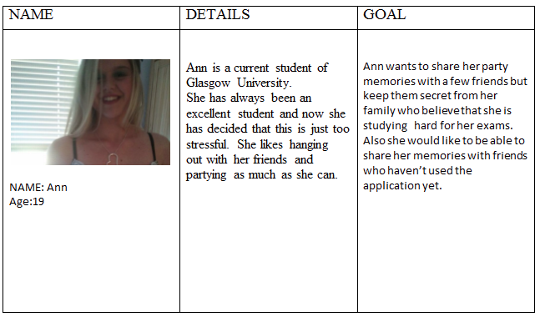
Personas

Slide 6
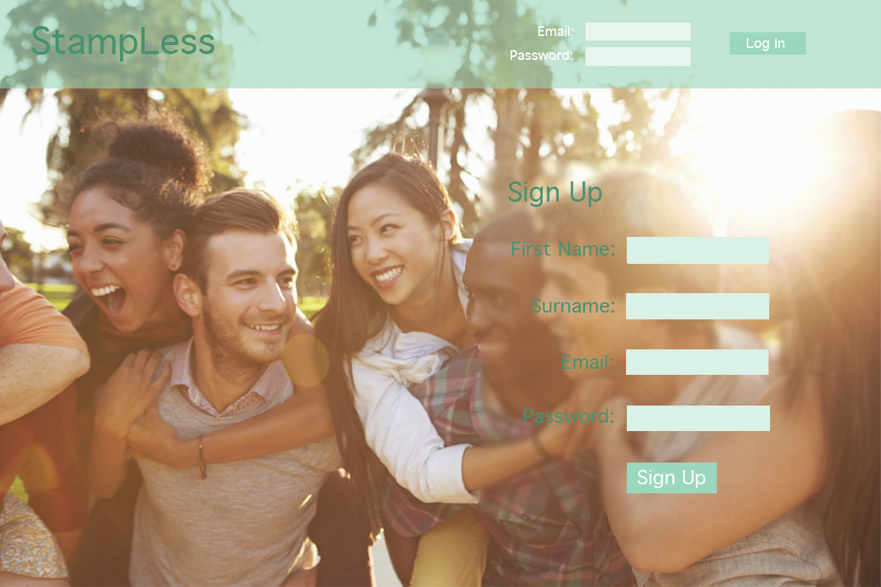
Login Page

Slide 7
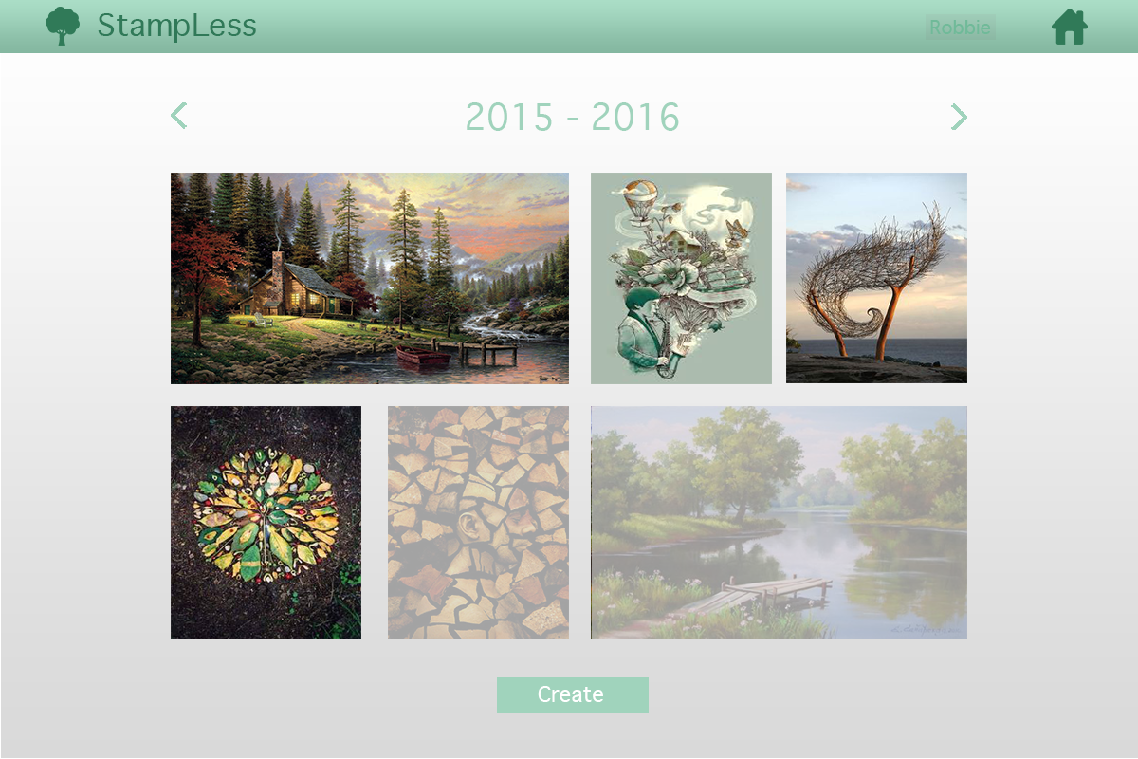
Homepage

Slide 8
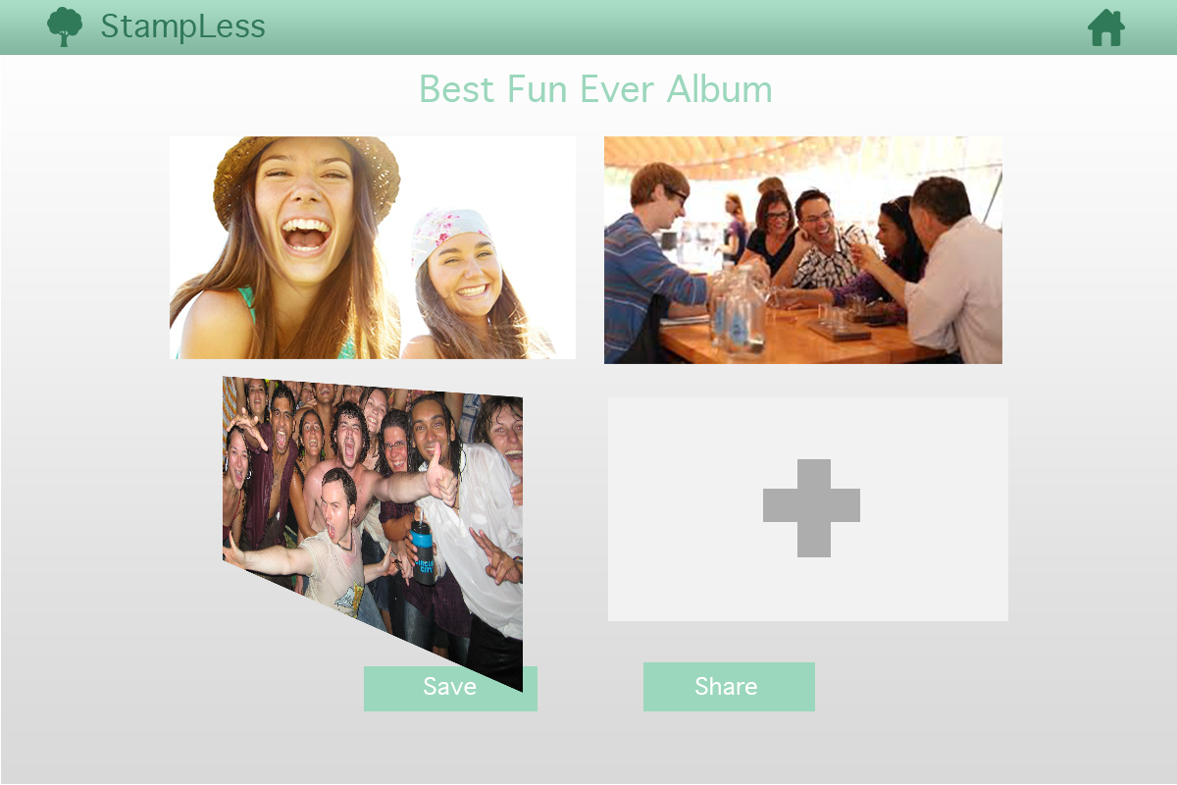
Album

Slide 9
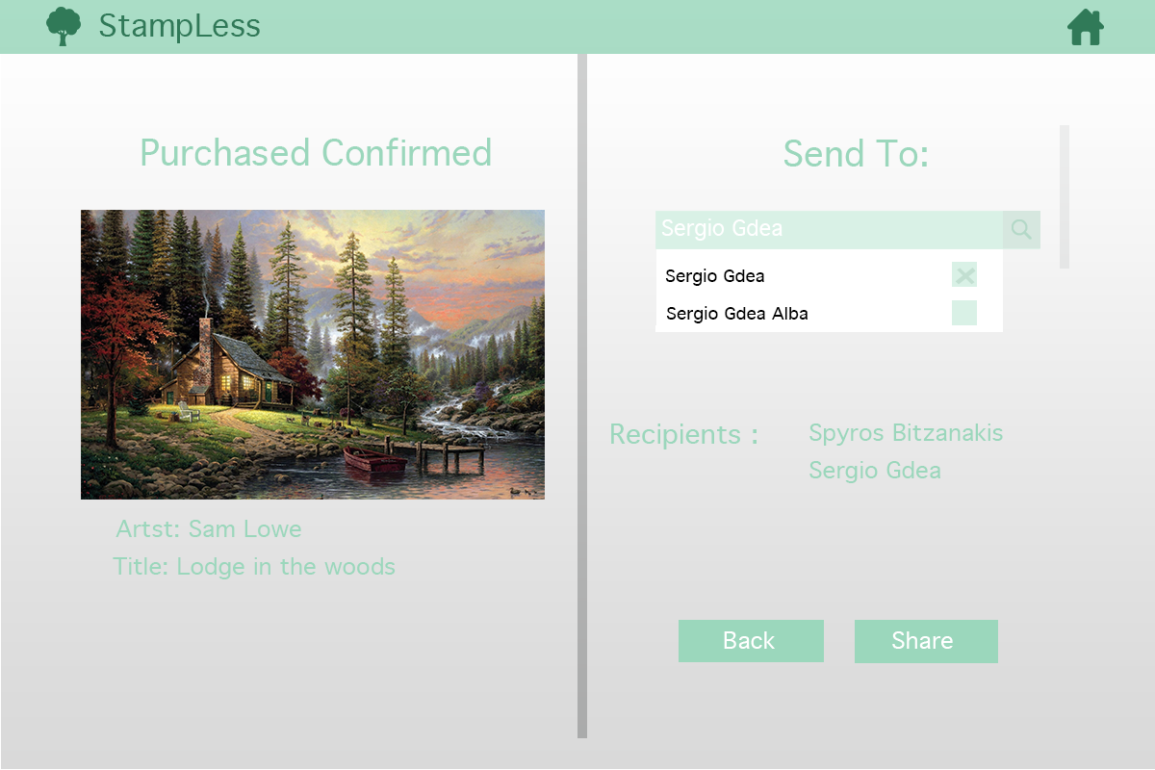
Send To Page

Slide 10
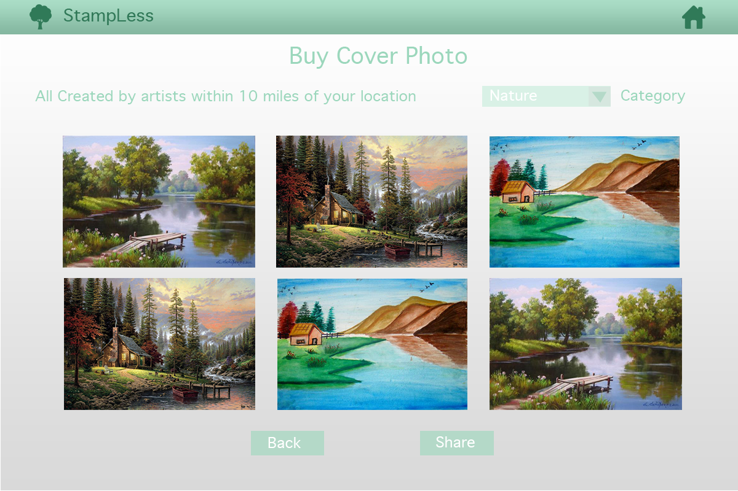
Artist Marketplace for covers

Slide 11
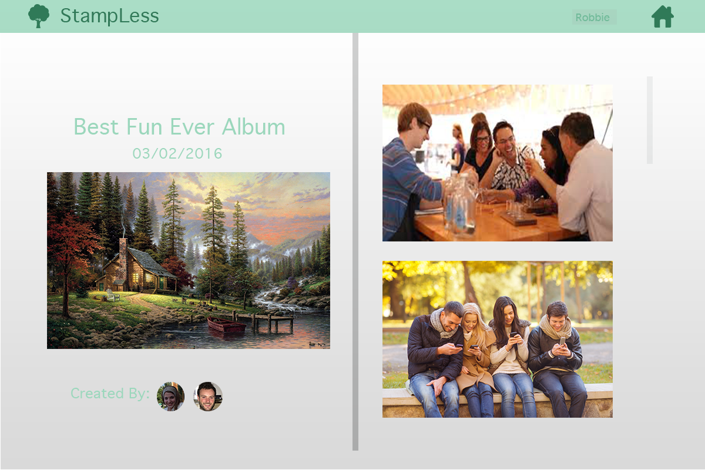
Finalised Album

Slide 12
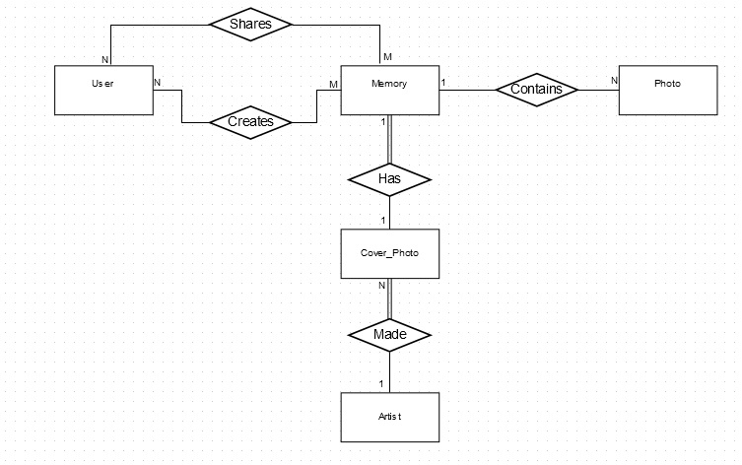
ER Diagram

Slide 13
Attributes
User
Photo
Cover_Photo
Field | Type
User_id | int
Email | char
Password | Hashed char
First Name | String
Last Name | String
Field | Type
Photo_id | int
Memory_id | int
User_id | int
Note | String
Field | Type
Cover_id | int
Artist_id | int
Memory_id | int
Price | double
Category | char

Slide 14
Attributes(2)
Memory
Artist
Field | Type
Title | String
Photo_id | int
Completed | boolean
Field | Type
Name | String
Artist_id | int

Slide 15













Client side - > Responsive design using twitter
Bootstrap framework + jQuery + HTML5
Web App Server
Amazon EC2
Instance
Running Django
Local relational
SQL DB
Users
AWS S3
+ Static files (CSS, JS, etc.)
+ Media files

